Slide 1
MAJOR PROJECT [Under the guidance of Dr. Bharti Sharma]
COMPARATIVE STUDY OF EEG SIGNAL
CLASSIFICATION USING DEEP LEARNING
FOR BIOMEDICAL APPLICATIONS
Deepanshi Dabas, Ayushi, Mehak Lakhani CSE (evening) - 8th semester
Jan 2020 - May 2020
Maharaja Surajmal Institute of Technology

Slide 2
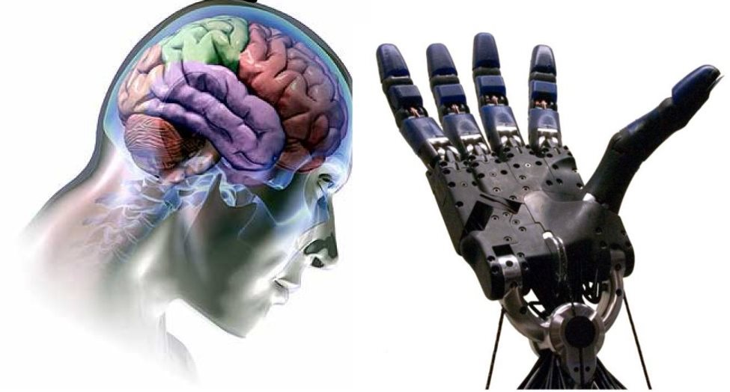
KEY IDEA
EEG is widely used in the research involving biomedical engineering (e.g. brain computer interfaces, BCI), neural engineering, neuroscience, seizure detection and sleep analysis because of its high temporal resolution, non-invasiveness, and relatively low financial cost. This study aims to perform a comparative study of different deep learning algorithms and implementing them on the datasets of two neurological disorders – Epilepsy Seizure and Schizophrenia. Early detection of these disorders can facilitate a wider scope of treatments that can come of aid to the patient. Using EEG as a tool for fast detection of the diseases at an early stage and integrating this with deep learning tools can provide better diagnosis. Recently, deep learning has shown a significant role in this field due to its capacity to learn good feature representations from raw data and could be extended further for a generalized detection of neural disorders.

Slide 3
TIMELINE
DATA ACQUISITION
DATA PRE-PROCESSING
CLASSIFICATION
COMPARATIVE ANALYSIS

Slide 4
DATA ACQUISITION

Slide 5
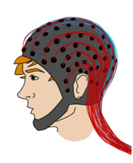
EEG
EEG tracks and records brain wave patterns
The electrodes analyze the electrical impulses in the brain and send signals to a computer
Compared to other techniques of neuro imaging, EEG is most convenient and thus Brain Computer Interface is based on EEG signals
Electroencephalography

Slide 6
the datasets

Slide 7
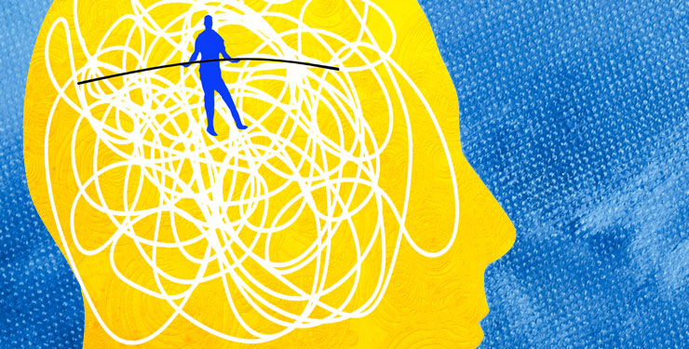
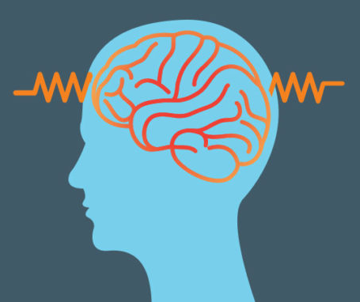
For our study, we have gathered the datasets of two neural disorders from online sources.
Schizophrenia Dataset :
Schizophrenia is a serious mental disorder in which people interpret reality abnormally. Schizophrenia may result in some combination of hallucinations, delusions, and extremely disordered thinking and behavior that impairs daily functioning, and can be disabling.
Epilepsy Seizure Recognition Dataset :
Epilepsy is a central nervous system (neurological) disorder in which brain activity becomes abnormal, causing seizures or periods of unusual behavior, sensations, and sometimes loss of awareness.

Slide 8
the experiments
epilepsy seizure dataset:
data set represents of signals belonging to several healthy and epileptic patients. The EEG data used in our study were downloaded from 24-h EEG recorded from both epileptic patients and normal subjects. The following bipolar EEG channels were selected for analysis: F7-C3, F8-C4, T5-O1 and T6-O2. In order to assess the performance of the classifier, we selected 500 EEG segments containing spike and wave complex, artifacts and background normal EEG
schizophrenia dataset:
used a simple button pressing task in which subjects either pressed a button without generating a tone to study the corollary discharge in people with schizophrenia and comparison controls. We found that comparison controls suppressed the N100, a negative deflection in EEG brain wave 100 milliseconds after the onset of a sound, when they pressed a button to generate a tone compared to passive playback, but patients with schizophrenia did not. Specifically, EEG data from 22 controls and 36 patients with schizophrenia have been combined with 10 controls and 13 patients from the previous report.

Slide 9
DATA PRE-PROCESSING

Slide 10
Pre-processing of datasets
epilepsy seizure dataset:
EEG signals are used in sections of 23.6 seconds, 173 Hz sampling frequency. Data is passed through the filter of 0.53–40 Hz band–pass. The original dataset from the reference consists of 5 different folders, each with 100 files, with each file representing a single subject/person. Each file is a recording of brain activity for 23.6 seconds.
The corresponding time-series is sampled into 4097 data points. Each data point is the value of the EEG recording at a different point in time. So we have total 500 individuals with each has 4097 data points for 23.5 seconds.
We divided and shuffled every 4097 data points into 23 chunks, each chunk contains 178 data points for 1 second, and each data point is the value of the EEG recording at a different point in time.
So now we have 23 x 500 = 11500 pieces of information(row), each information contains 178 data points for 1 second(column), the last column represents the label y {1,2,3,4,5}.

Slide 11
Continued -
schizophrenia dataset:
0.1 Hz high-pass filter
Chop continuous data into single trial epochs 1.5 seconds before and after task events (3s total)
Rejection of outlier single trials
Derived data includes event-related potential (ERP) averages for 9 electrode sites including Fz, FCz, Cz, FC3, FC4, C3, C4, CP3, CP4.
For comparing patients with schizophrenia to control subjects, ERP time series for all subjects, conditions, and the 9 electrodes mentioned above is used.

Slide 12
CLASSIFICATION

Slide 13
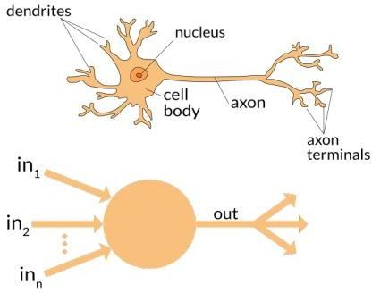
ANN (Artificial Neural Networks)
Artificial Neural Network (ANN) uses the processing of the brain as a basis to develop algorithms that can be used to model complex patterns and prediction problems. It is a computing system vaguely inspired by biological neural networks. An ANN is based on a collection of connected units or nodes called neurons, which loosely model the neurons in a biological brain. Each connection can transmit a signal to other neurons. ANNs can better model data with high volatility and non- constant variance, given its ability to learn hidden relationships in the data without imposing any fixed relationships in the data.

Slide 14
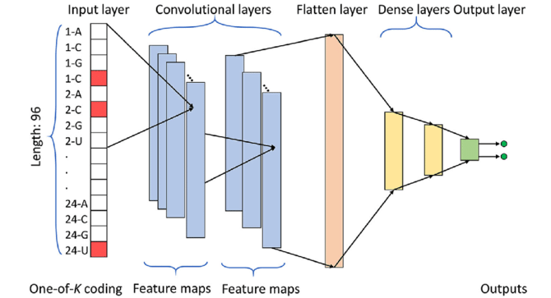
CNN (Convolutional Neural Networks)
Convolutional Neural Networks (CNN) is one of the variants of neural networks used heavily in the field of Computer Vision. It derives its name from the type of hidden layers it consists of. The hidden layers of a CNN typically consist of convolutional layers, pooling layers, fully connected layers, and normalization layers. Here it simply means that instead of using the normal activation functions defined above, convolution and pooling functions are used as activation functions. . In layman terms it takes in an input signal and applies a filter over it, essentially multiplies the input signal with the kernel to get the modified signal.

Slide 15
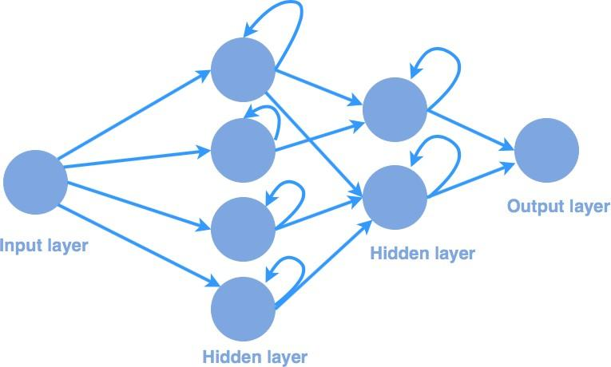
RNN (Recurrent Neural Networks)
Recurrent Neural Networks or RNN as they are called in short, are a very important variant of neural networks heavily used in Natural Language Processing. In a general neural network, an input is processed through a number of layers and an output is produced, with an assumption that two successive inputs are independent of each other. RNN is the first algorithm that is able to remember its inputs, due to its internal states that makes RNN perfect for machine learning problems that involve sequential data. Another way to think about RNNs is that they have a “memory” which captures information about what has been calculated so far. In theory, RNNs can make use of information in arbitrarily long sequences, but in practice, they are limited to looking back only a few steps.
Sharmila, A., and P. Geethanjali. "DWT based detection of epileptic seizure from EEG signals using naive Bayes and k-NN classifiers." Ieee Access 4 (2016): 7716-7727.

Slide 16
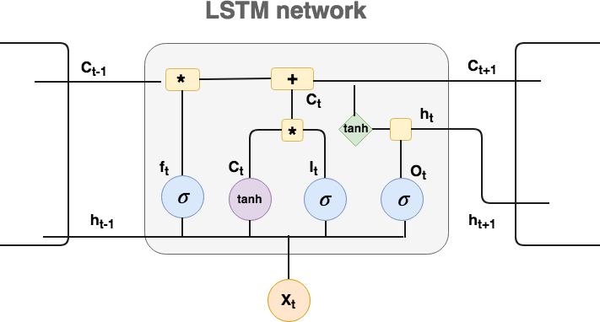
LSTM (Long-Short term Memory)
A LSTM cell is a type of RNN which stores important information about the past and forgets the unimportant pieces. In this way, when gradient back-propagates, it won’t be consumed by unnecessary information. LSTM enables RNN to remember its inputs over a long period of time. This is because LSTM contains its information in a memory that is much like the memory of a computer because the LSTM can read, write and delete information from its memory. So because of LSTM, now RNN can analyze text and answer questions, which involves keeping track of long sequences of words. In LSTM, you have three gates: input, forget and output gate. These gates decide whether or not to let new input in (input gate), delete the information because it isn’t important (forget gate) or to let it effects the output at the current time step (output gate).

Slide 17
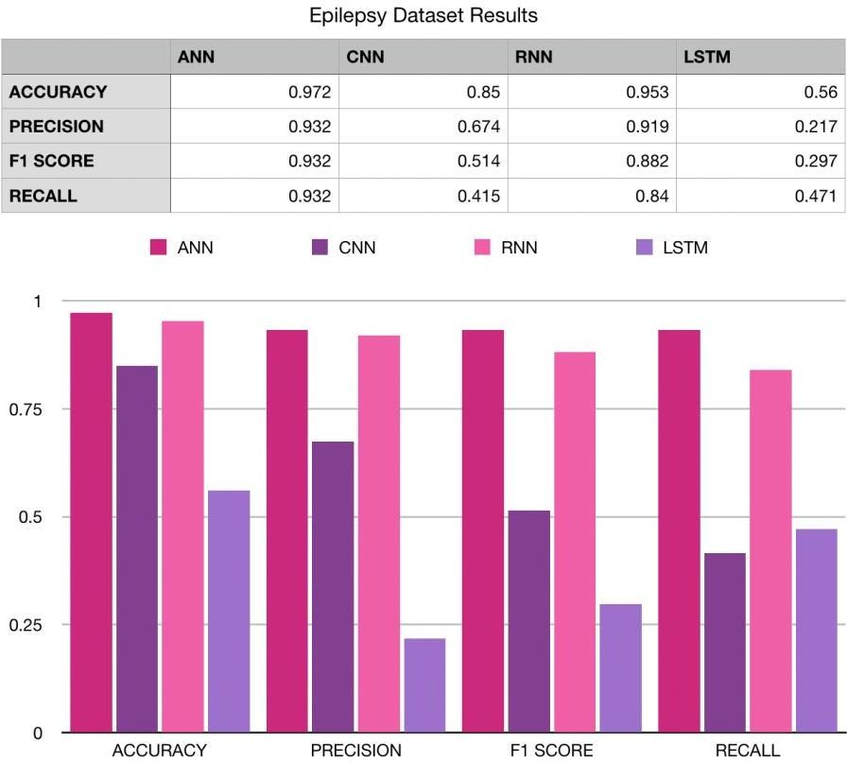
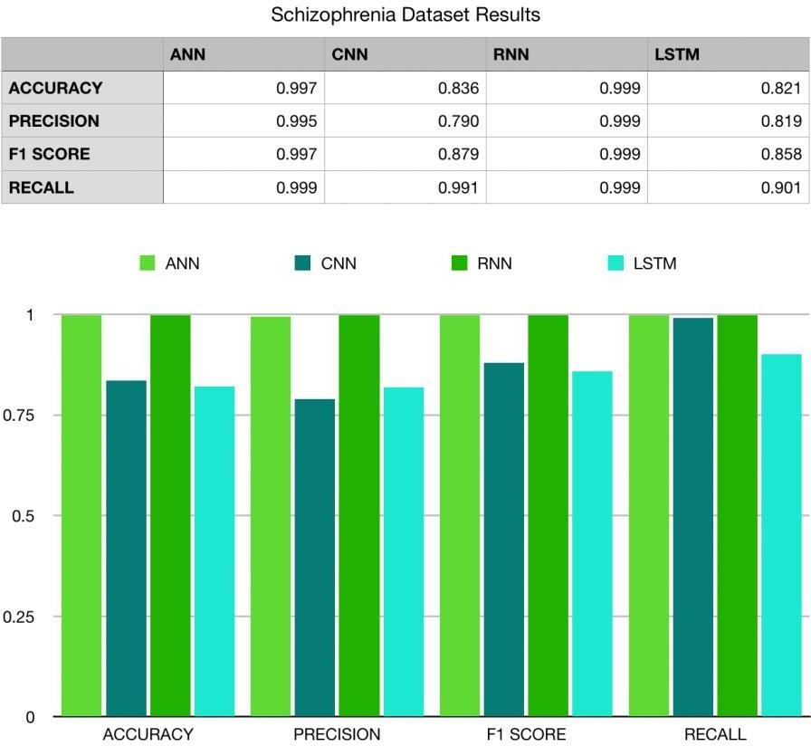
a comparative analysis...
All the algorithms mentioned above are performed on the Epilepsy and Schizophrenia dataset. After implementation of the code performed on the dataset, various parameters are considered such as accuracy, precision value, recall rate and F1 score. The results obtained from these algorithms helped us in comparing and understanding which algorithm is better. The algorithm with highest accuracy can then be used for the treatment purpose further and can help us in achieving our goal. Deep learning can help in early detection of these disorders which can be beneficial in the treatment process.

Slide 18
Conclusion
The aim of this project was to perform the comparative analysis using deep learning in the field of biomedical science and its applications and implementing various algorithms on the given dataset of brain disorders and check which algorithms fits with highest accuracy and can be used further. Study of various research papers on EEG based classification and Deep Learning Models and Algorithms has been done and a literature survey has been maintained for the same. Therefore, we can say now that using EEG as a tool for fast detection of the diseases at early stage and integrating this with deep learning tools can provide better diagnosis.
According to the literature survey, ANN (Artificial Neural Networks), CNN (Convolutional Neural Networks), RNN (Recurrent Neural Networks) and LSTM (Long-Short Term Memory) are the four deep learning algorithms that can be used in the biomedical sciences field in order for the early detection of the brain disorders. In this study, RNN was found with the highest accuracy and can be used for the future purpose of diagnosing the disorder at the early stage. Training the patients suffering from neural disabilities, to initiate brain signals for controlling external devices, provides scope for extensive future development.

Slide 19
THANK
YOU

